Slide 1
MVC 5
(Model-View-Controller)
Kreiranje projekta i objekata
Notes:
Prije početka pitati za iskustva koja polaznici imaju oko MVC 4.

Slide 2
Kreiranje projekta

Slide 3
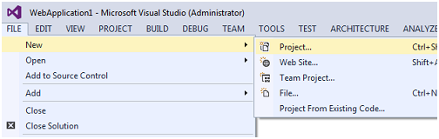
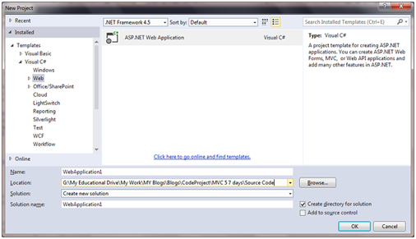
1. File -> New -> Project
2. Odaberite ASP.NET Web Application
Notes:
Do not go into too much detail about the different building blocks. It would be useful to walk the students through a scenario, such as a user logging into a website showing which blocks are used and why. Do not spend much time on CGI, Tracing or compression. This is primarily an architecture slide.
Module 1: Overview of Web Application Design
Course 10264A

Slide 4
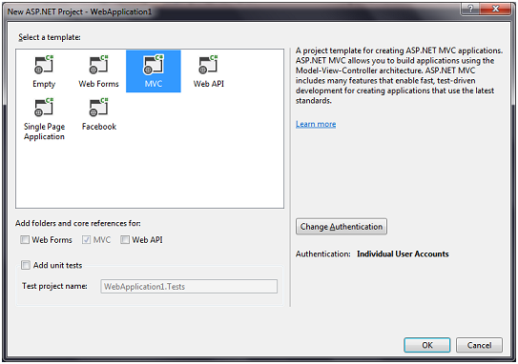
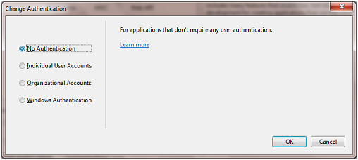
3. Odaberite MVC
4. Odaberite - No Authentication
Notes:
Do not go into too much detail about the different building blocks. It would be useful to walk the students through a scenario, such as a user logging into a website showing which blocks are used and why. Do not spend much time on CGI, Tracing or compression. This is primarily an architecture slide.
Module 1: Overview of Web Application Design
Course 10264A

Slide 5
3. Odaberite MVC
4. Odaberite - No Authentication
Notes:
Do not go into too much detail about the different building blocks. It would be useful to walk the students through a scenario, such as a user logging into a website showing which blocks are used and why. Do not spend much time on CGI, Tracing or compression. This is primarily an architecture slide.
Module 1: Overview of Web Application Design
Course 10264A

Slide 6
Kreiranje glavnih objekata

Slide 7
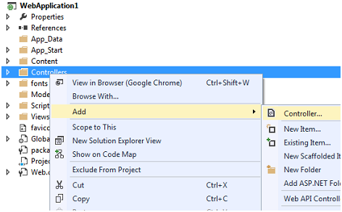
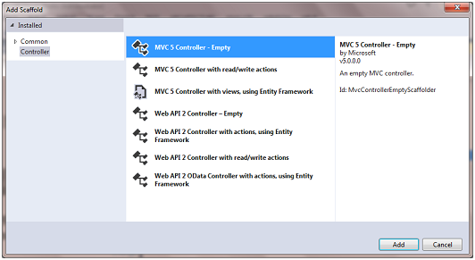
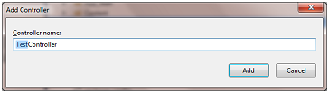
Kreiranje Controllera
1.
2.
3.

Slide 8
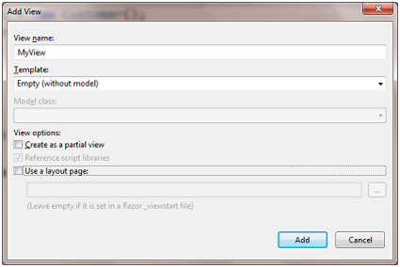
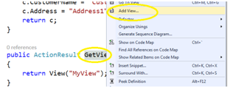
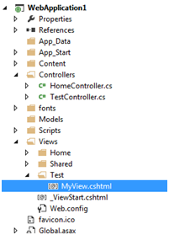
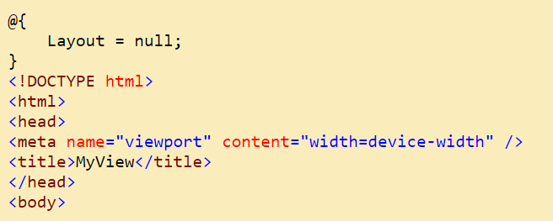
Kreiranje Viewa
1.
=>
2.
=>

Slide 9
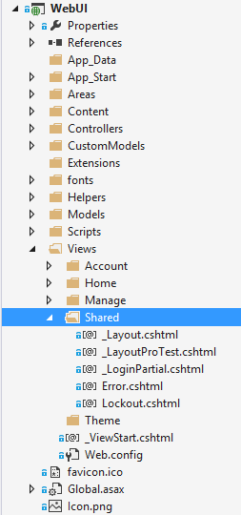
Dijeljeni View-ovi
Unutar direktorija Shared se kreiraju View-ovi koje koristi cijela aplikacija:

